Slide 1
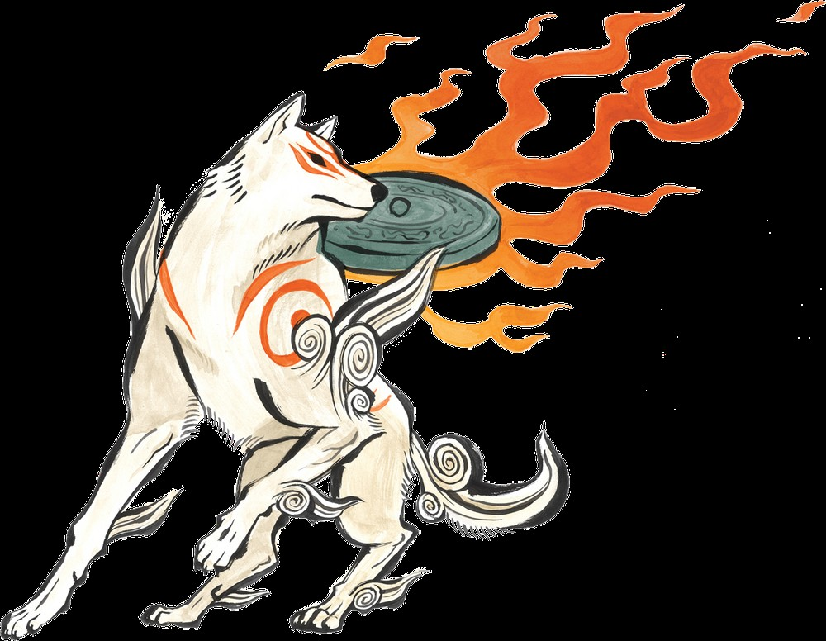

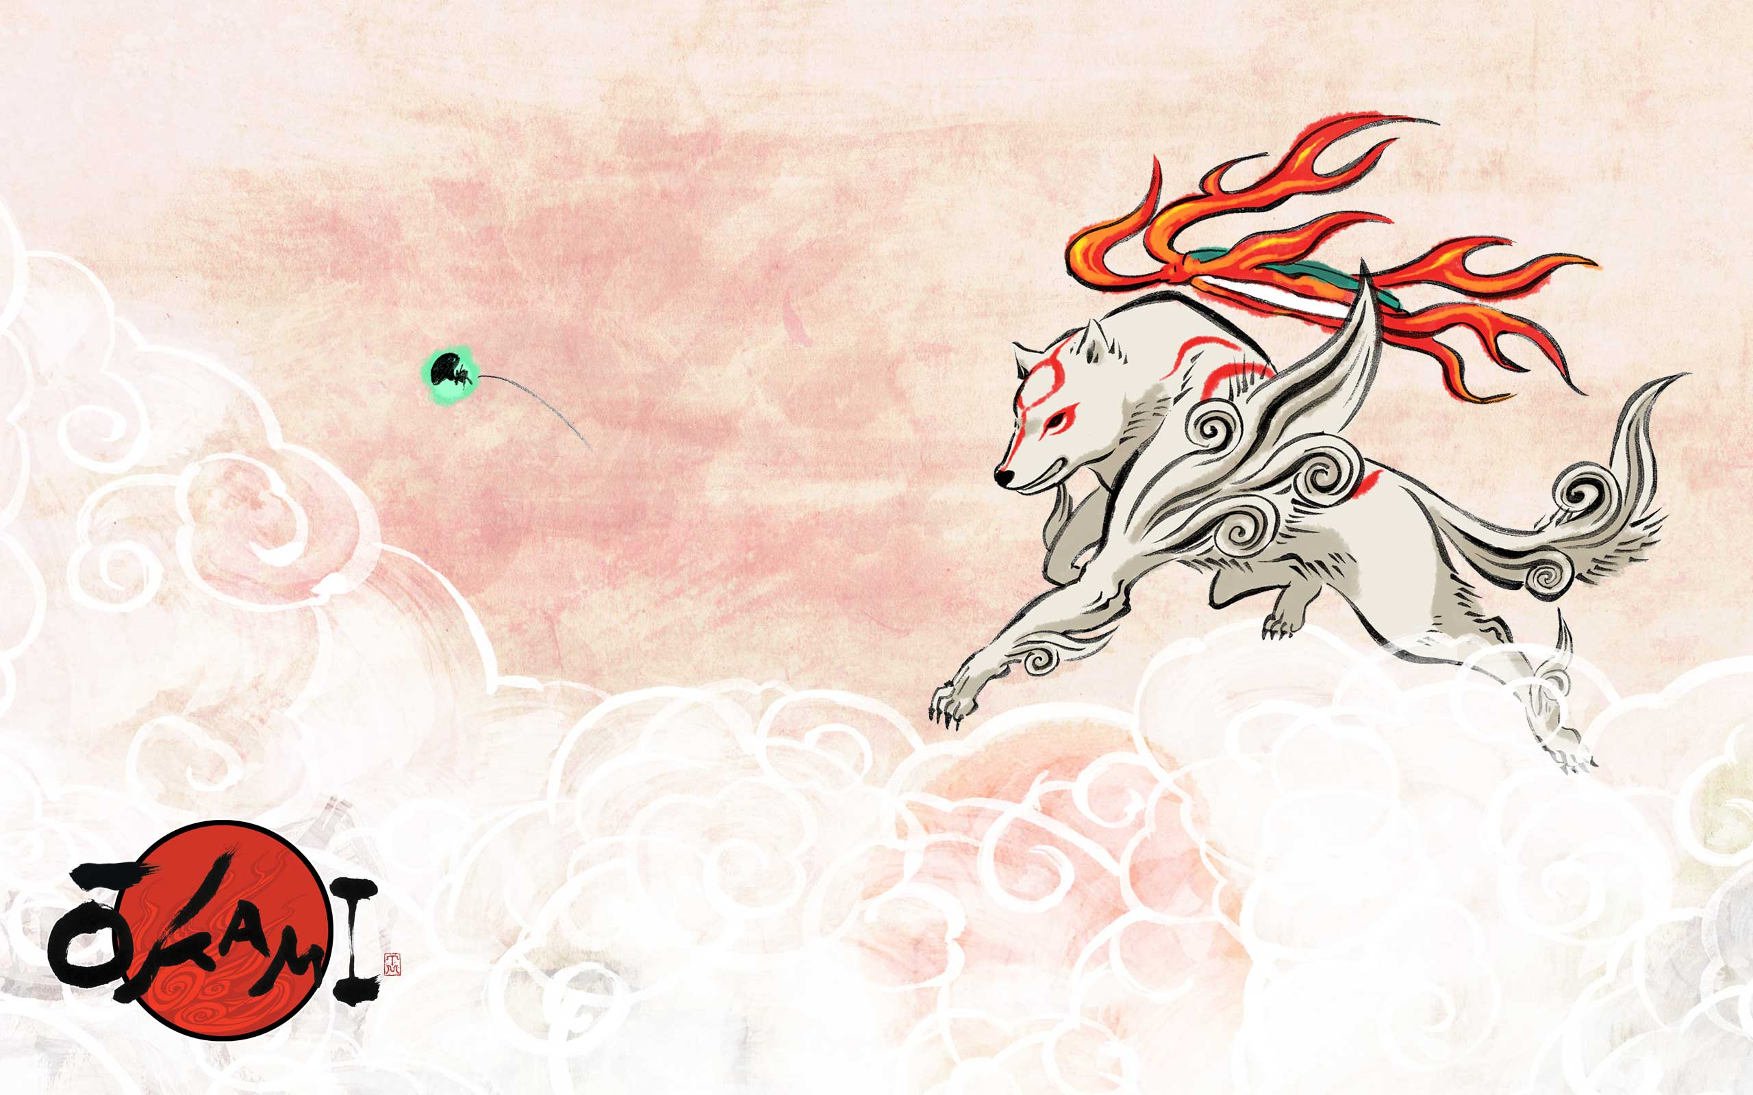
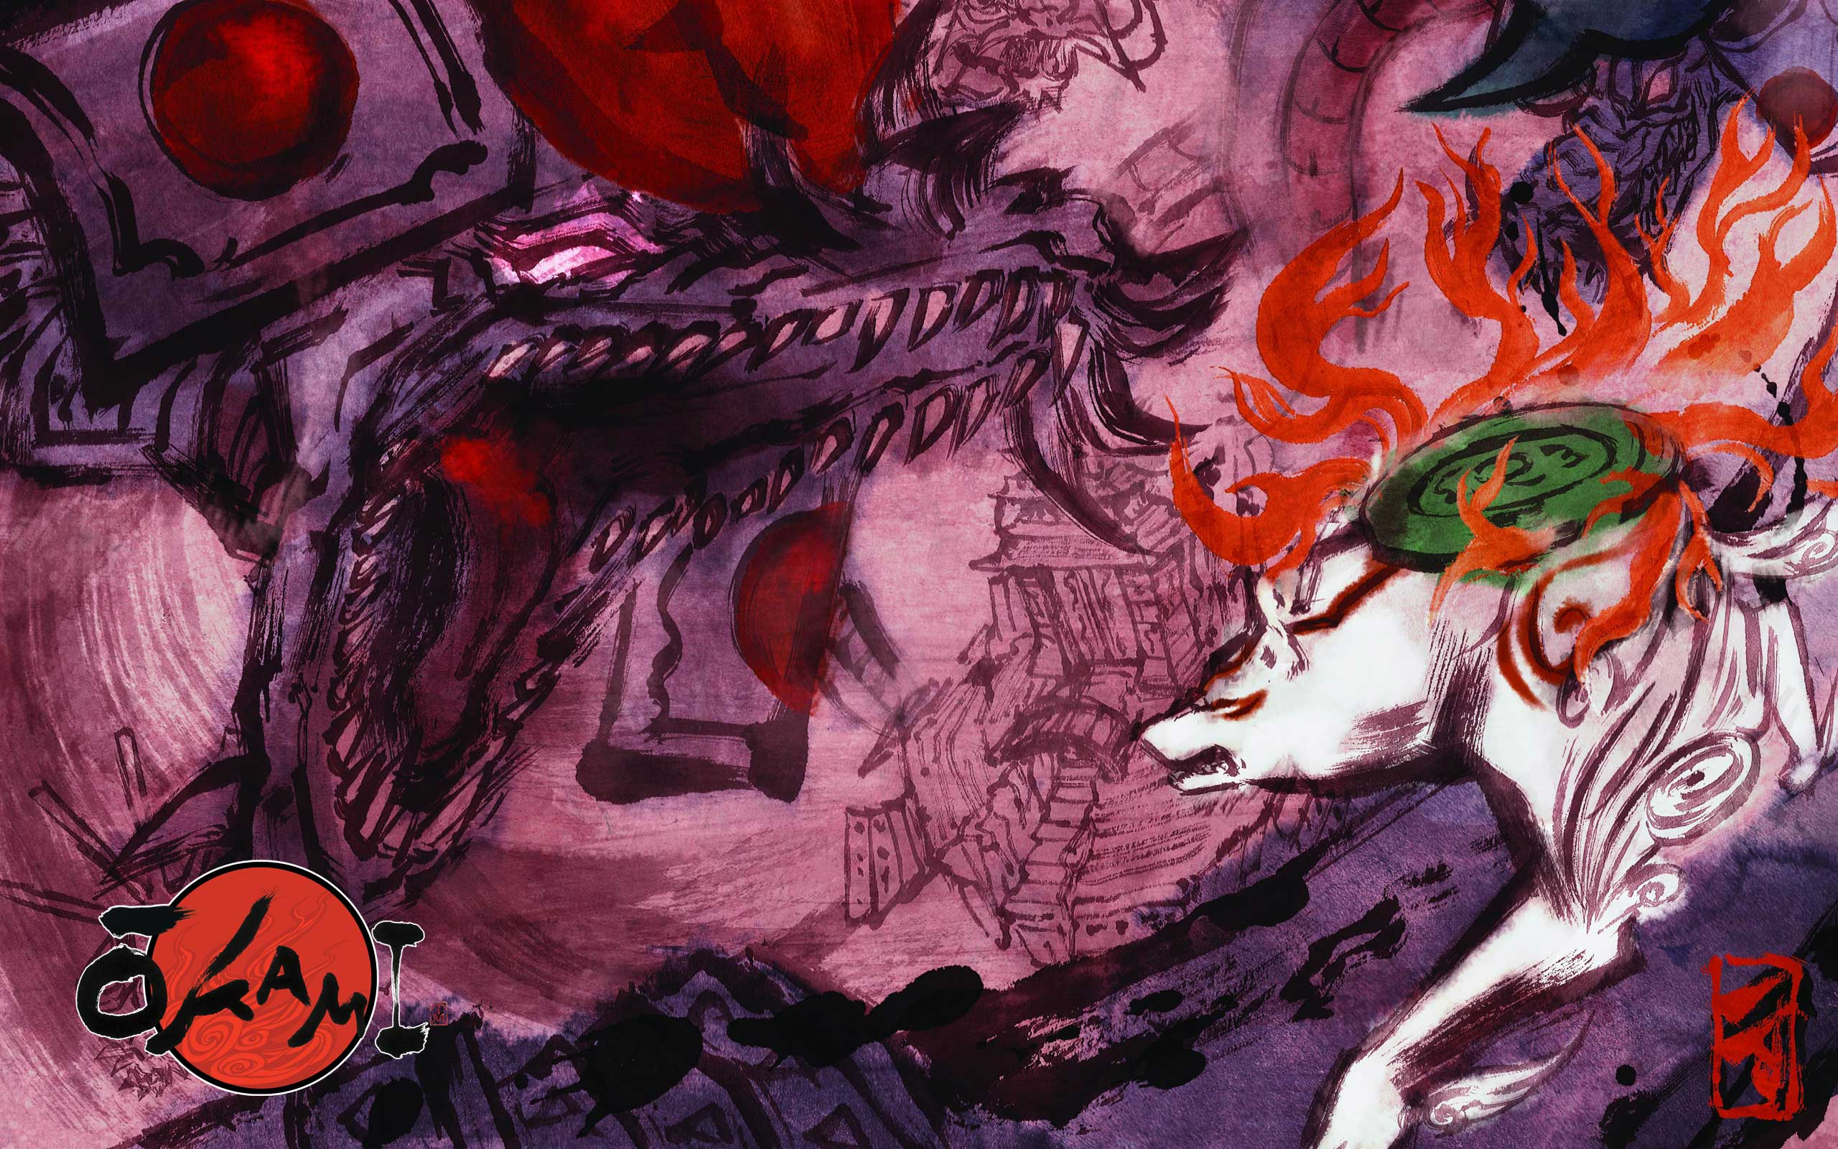
From Constraint to Canvas
Ōkami's Ukiyo-e Aesthetic as Cultural Resistance
Yilun Jin
ARTH 125A • Dr. Adriana
Dec 3, 2025
Notes:
Good afternoon everyone, my name is Yilun.
For my visual analysis essay, I chose Ōkami.
This game is Capcom’s game, and today is my
first presentation in America, and I feel a little nervous.
But I believe in myself.

Slide 2
The Design Pivot
THE ORIGINAL PLAN
Photorealistic graphics pushing PlayStation 2 hardware to its limits
THE PIVOT
Kenichiro Yoshimura's brush sketch of Amaterasu changed everything in three days
THE RESULT
A bold commitment to 18th century Japanese aesthetics: ukiyo-e woodblock prints and sumi-e ink painting
Technical constraint became creative opportunity
Notes:
"In 2003, Clover克洛弗 Studio had a problem. Their realistic graphics didn't work on PlayStation 2. Then one artist 肯尼奇罗游锡木拉
drew a simple brush picture of Amaterasu, and in three days, the team changed everything. They decided to
use old Japanese art style. The problem became an opportunity."

Slide 3

Thesis & Framework
Through 18th century Japanese aesthetics, Ōkami demonstrates critical play — using game design to question visual norms and challenge the gaming industry's preference for photorealism.
1. Divine Imagery
2. Spatial Style
3. Brush Mechanic
Amaterasu's sumi-e design and Shinto symbolism
Ukiyo-e flat perspective and color restoration
Interactive sumi-e as radical game design
Framework: Mary Flanagan's concept of "critical play"
Notes:
Ōkami uses traditional Japanese art to question normal game design.(阿玛特拉苏)
Amaterasu’s sumi-e(苏米·诶) style, the flat ukiyo-e (乌ki哟诶) space, and the brush tool each show how limitations can become strengths.
苏米·诶
乌ki哟诶

Slide 4
Amaterasu: Sumi-e & Shinto Symbolism
SUMI-E BRUSHWORK
Thick black outlines carry the artist's "Ch'i" (life force), exaggerated for 3D readability
RED TOMOE MARKINGS
Spiral patterns symbolize cosmic motion, signaling divine role in restoring balance
SACRED MIRROR (YATA NO KAGAMI)
Fiery disk on back references sun goddess mythology
HOKUSAI-INSPIRED TAIL
Uneven curves recall wave shapes from classic woodblock prints
Figure 1: Amaterasu's design
Traditional meets modern: both authentic and surprisingly contemporary
Notes:
the goddess design. Amaterasu(阿玛特拉苏) uses thick（c课） black lines like traditional ink painting. These lines carry the artist's energy. The red circular patterns show divine power. Old Japanese art becomes modern game character（卡拉克特） with true cultural feeling.
托-莫-诶

Slide 5
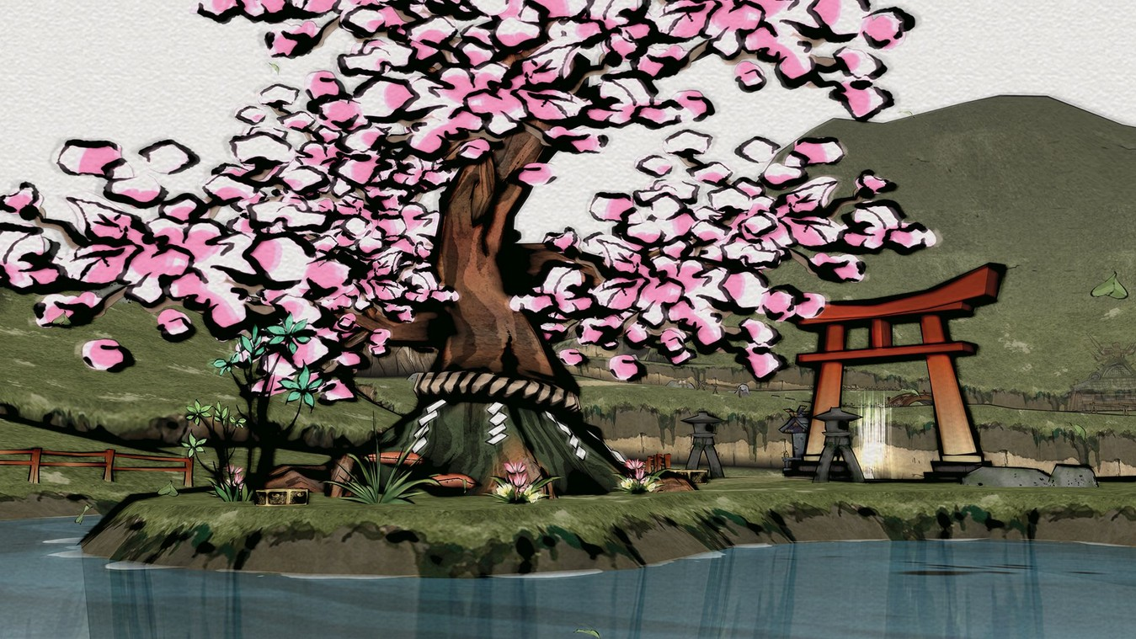
Ukiyo-e Spatial Design
Flattened Perspective
Space built through overlapping shapes, not vanishing points
Flat Color Areas
Large blocks bordered by fine line drawing — mirrors woodblock printing
Yorishiro Sacred Objects
Shimenawa ropes and torii gates mark spaces that invite kami
Color as Narrative
Figure 2: Cherry blossom scene with torii gate
Cursed areas appear gray; restoration returns vibrant ukiyo-e colors
Space created through overlapping shapes, not vanishing points
Notes:
Ōkami doesn't use Western perspective.
It uses flat layers — space made by overlapping shapes.
Color tells the story: cursed areas look gray, and restoration brings back bright colors.

Slide 6
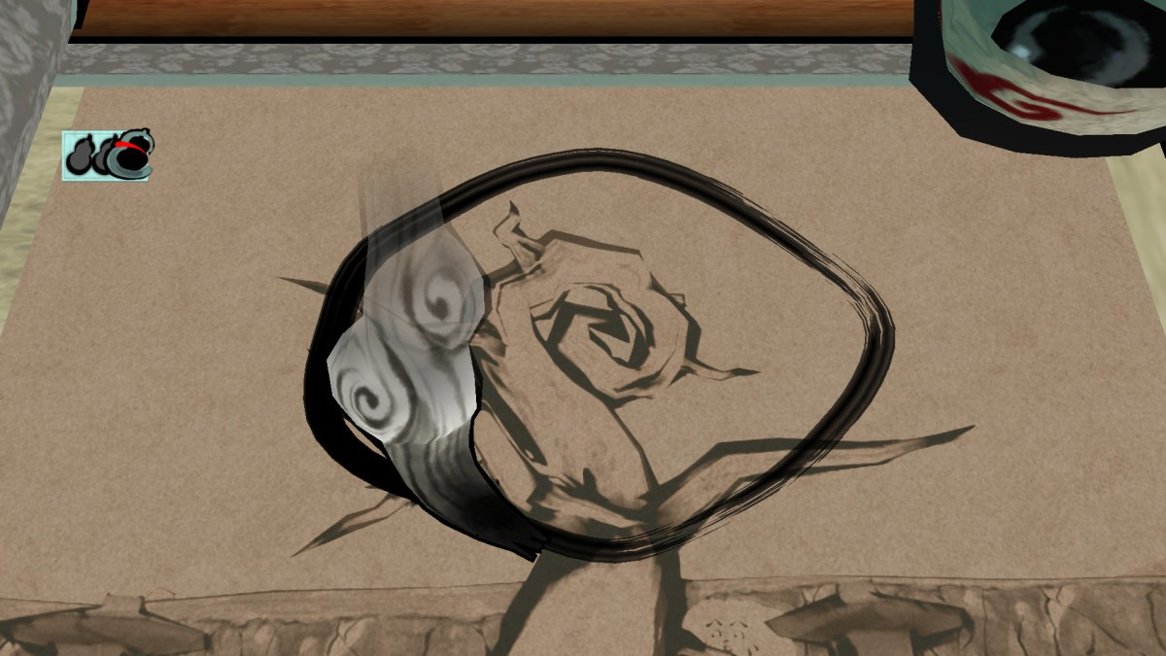
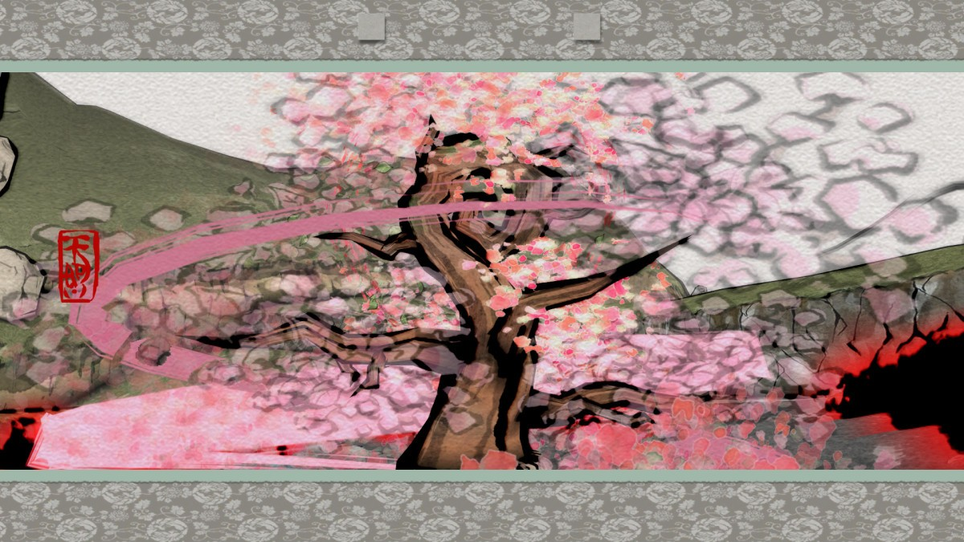
Celestial Brush: Interactive Sumi-e
BEFORE
AFTER
CRITICAL PLAY IN ACTION
Players perform sumi-e brushwork directly — turning representation into interaction
No Undo
Ecological
Like ink, strokes cannot be erased
Restoration replaces destruction
"Radical game design" — interaction questions norms (Flanagan)
Notes:
The game asks players to paint with a joystick, which is not precise.
This difficulty is intentional — it slows the player down, making brushwork feel physical, like real ink painting.
No erasing（a rising）, no perfection — restoring nature becomes a meaningful action, not just a mechanic.

Slide 7

Technical Understanding
From Visual Analysis to Technical Knowledge
Black outlines
→ Edge detection
Flat colors
→ Cel shading
Red patterns
→ Computer generation
Ōkami Style Egg
Notes:
"Through my analysis, I learned how these effects work. Those thick black lines? Edge detection. The flat
colors? Cel shading. Red patterns? Computer generation.
This demo shows: my analysis helps understand how the art works technically."

Slide 8
The Paradox of Failure
Critical Success
Commercial Reality
BAFTA
~90K
Artistic Achievement
Initial sales
"Least commercially successful winner of a Game of the Year award"
— Guinness World Records
The contrast proves the radicalism: Non-Western visual traditions challenged the gaming industry's preference for photorealism. Commercial failure validates the game's role as cultural resistance.
Technological constraint transformed into cultural statement
Notes:
Here's something interesting: Ōkami won Game of the Year but only sold 90,000 copies at first.
Guinness Records says it was the 'least successful Game of the Year winner.'
This proves it was radical. The different art style was too different for many players.

Slide 9

Tradition as Resistance
Ōkami transforms technological limitation into cultural preservation:
Amaterasu's sumi-e body carries artistic life force
Ukiyo-e spaces reject Western perspective systems
Celestial Brush turns centuries-old technique into interactive system
Tradition is not dead or old-fashioned—
it remains a powerful form of creative resistance
in global game culture.
Cultural preservation as radical innovation
Notes:
"Ōkami changes technical problems into cultural preservation.
Amaterasu's body carries artistic energy.
Flat space rejects Western rules.
The Brush turns restoration into gameplay.
Old tradition is not boring — it can be powerful creative resistance in global media."

Slide 10
All Materials Online
Full Paper
Demo Code
Presentation
On GitHub:
github.com/[your-username]/okami-analysis
You can download and see everything

